Slide 1
Overview of Storage-Ring Projects at Lanzhou
Xinwen Ma
Institute of Modern Physics, Chinese Academy of Sciences
ILIMA Meeting @ GSI-Helmholtz, 28, Feb, 2012

Slide 2
Outline
Examples of Progress on the present accelerator facility
The Future Projects

Slide 3

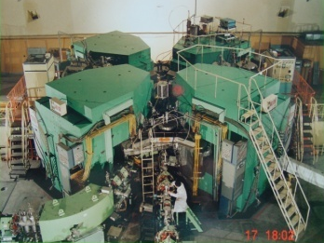
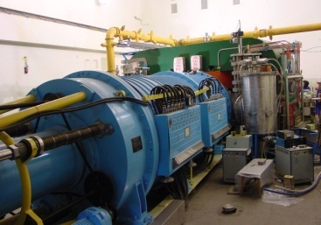
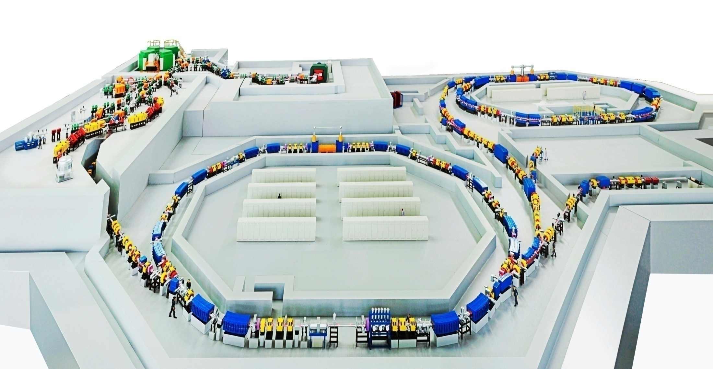
Accelerator Facilities
National Laboratory of Heavy Ion Accelerator in Lanzhou
SSC(K=450)
100 AMeV (H.I.), 110 MeV (p)
SFC (K=69)
10 AMeV (H.I.), 17~35 MeV (p)
CSRe
RIBLL1
RIBs at tens of AMeV
RIBLL2
RIBs at hundreds of AMeV
CSRm
1000 AMeV (H.I.), ≤ 2.8 GeV (p)
Heavy Ion Research Facility in Lanzhou (HIRFL)

Slide 4
Scientific Drivers
Main Scientific Activities at IMP
Fundamental researches on nuclear & atomic physics
  Structure and collision dynamics of exotic nuclear with RIB
  Mass measurement, γ-spectroscopy, and synthesis of new isotopes
  EoS of nuclear matter
  Chemistry of super-heavy elements
  Explosive nuclei synthesis, breaking of hot CNO, and rp-process
  HCI interaction with laser, electron, molecular, and surface
  HED physics
  Nuclear Theory
  Instrumentation
Applications with heavy ions
  Material science: nano-tech., nuclear energy structural material, …
  Radio-biology: tumor therapy, mutation breeding, …
Accelerator & experimental technique developments
Research on advanced nuclear fuel cycles: ADS

Slide 5
Experimental Sites at HIRFL
Mass measurements
IMS & SMS
Decay properties
Nuclear reaction
DR & RR
EX-T
μ-beam
In beam
γ spec.
X-ray
Material
irradiation
Reaction
PISA
DR & RR
Deep seated
Tumor Therapy
Gas filled
separator
Nuclear reaction
with unstable nuclei

Slide 6
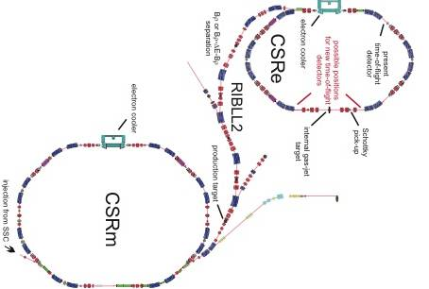
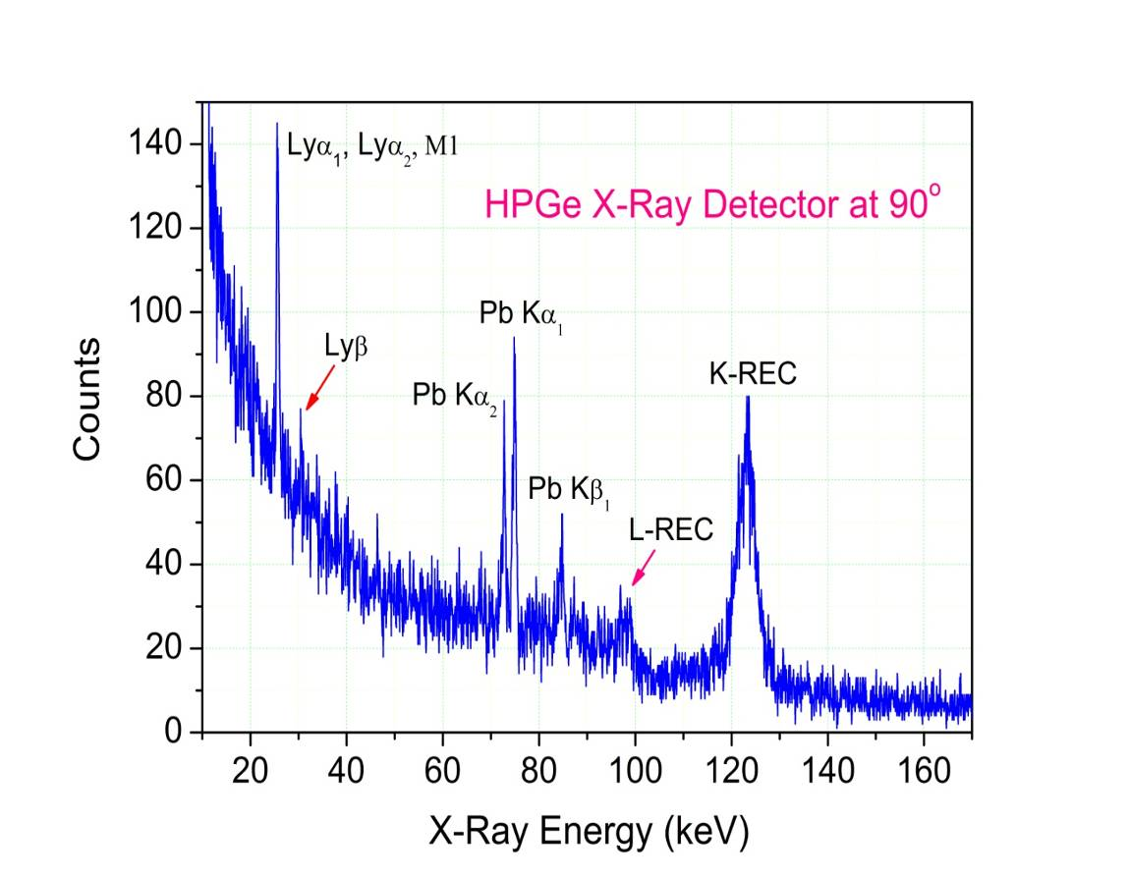
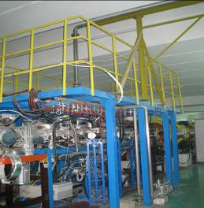
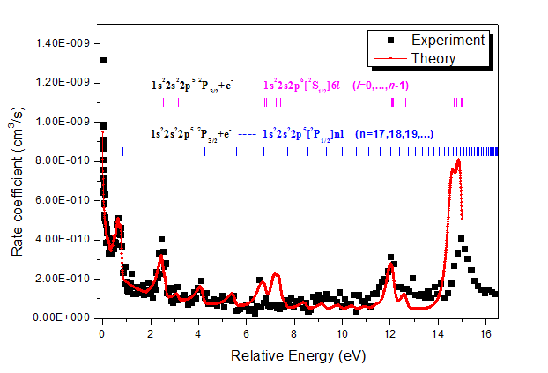
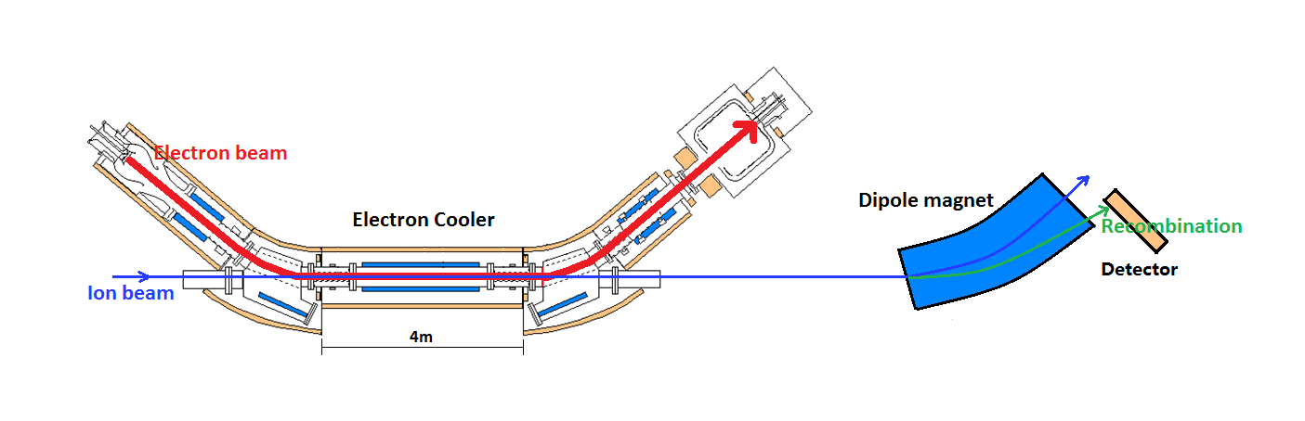
Atomic experiment at CSR
Radiative Electron Capture @gas jet
REC x-ray from Xe⁵⁴⁺ on N2
Dielectronic Recombination of Ni¹⁹⁺
Electron cooler and DR experiment

Slide 7
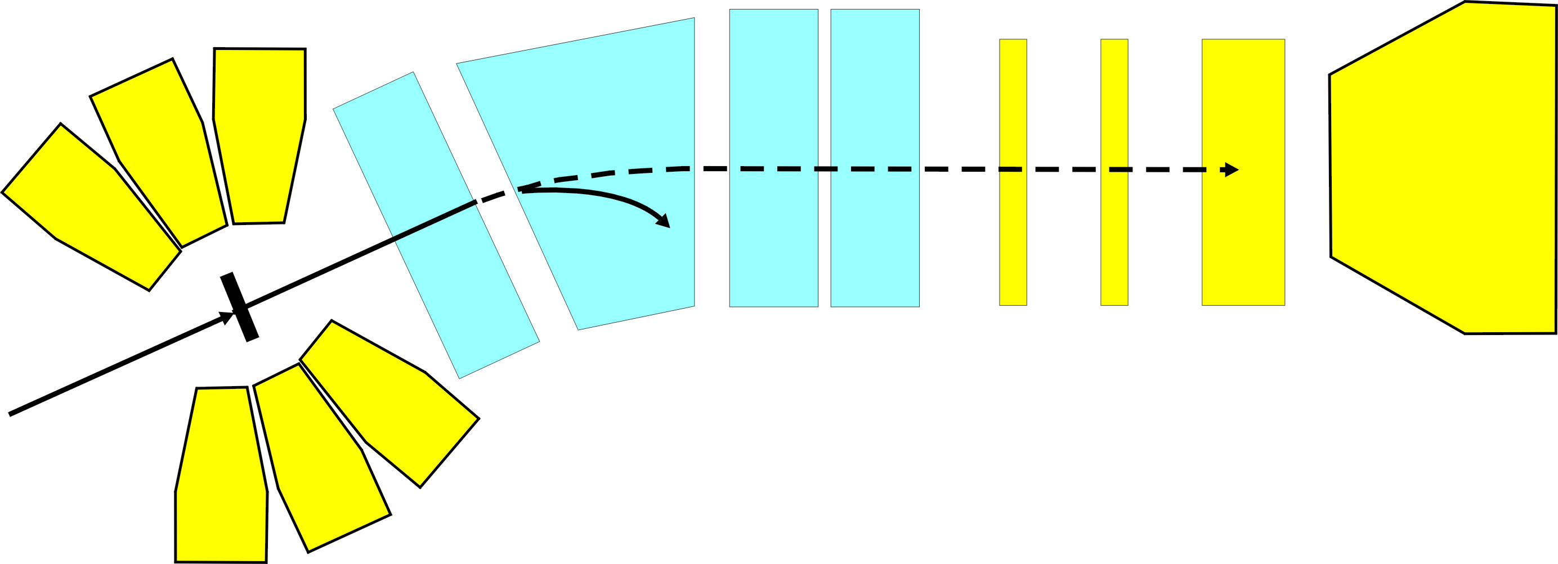
In-beam γ spectroscopy
Recoil separator
TOF
8Clovers+14Ges
Si
Q
Q
α,p
Ge
D
γ
Q
γ
Collective motions
Shape coexistences
Single particle excitations
Search for isomers
Decay studies
Synthesis of new isotopes
γ
γ
γ
isomer
α,p
γ
G.S
α,p
T₁＝0
T₂∼1μs
T₃ < 3T_{1/2}
Notes:
7
7

Slide 8
Mass measurement: facility and methods
RIBLL2: radioactive ion production
CSRe: mass & decay measurement
Time of Flight detector
γ_{t}=1.395 → 368 MeV/u
IMS: γ → γ_{t} SMS: dν → 0

Slide 9
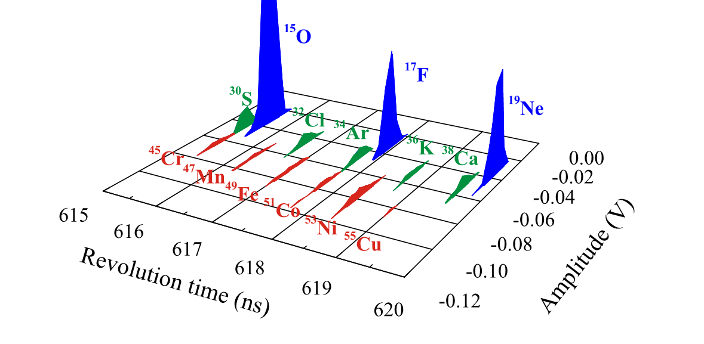
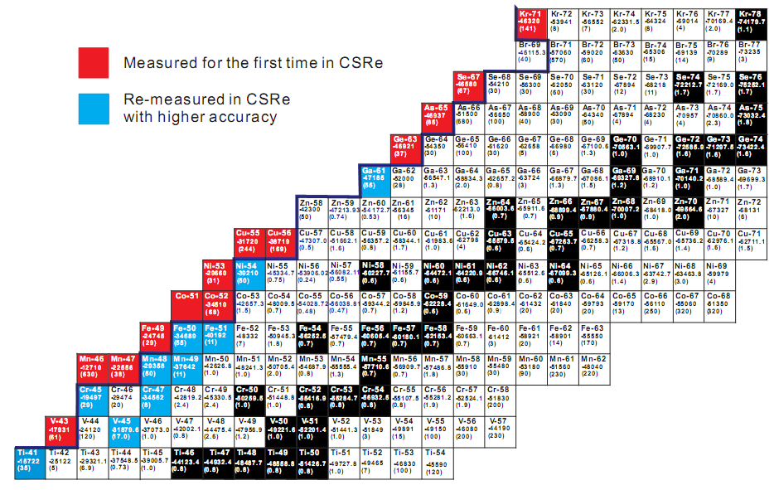
Mass measurement
m/∆m≈1.7x10⁵
Masses measured for the first time
⁴³V, ⁴⁶Mn, ⁴⁷Mn, ⁴⁹Fe, ⁵¹Co , ⁵²Co, ⁵³Ni, ⁵⁵Cu, ⁵⁶Cu, ⁶³Ge, ⁶⁵As, ⁶⁷Se, ⁷¹Kr
Masses with improved accuracy
⁴¹Ti, ⁴⁵V, ⁴⁵Cr, ⁴⁷Cr, ⁴⁸Mn, ⁴⁹Mn, ⁵¹Fe ⁴⁶Cr, ⁵⁰Fe, ⁵⁴Ni

Slide 10
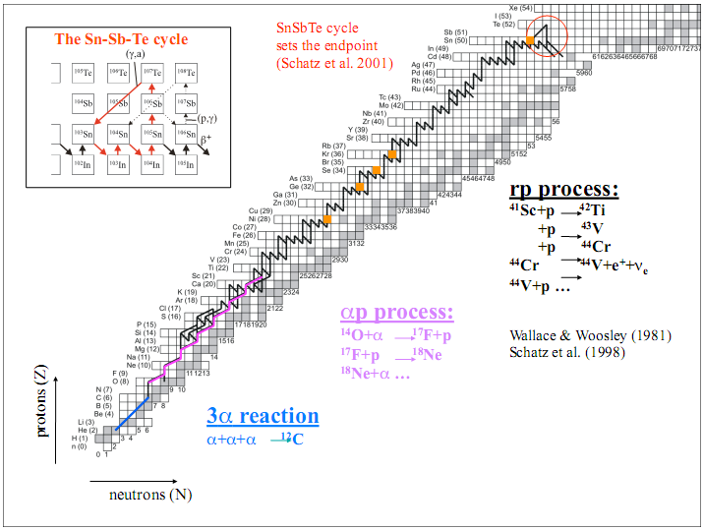
Importance of ⁶⁵As Mass
PRL 106, 112501(2011)
S_{p}(⁶⁵As) = -90 (85) keV
Waiting point ⁶⁴Ge?
90% of the reaction flow passes through 64Ge via proton capture
⁶⁵As is unbound with respect to proton emission
⁶⁴Ge is not a waiting point in the rp- process

Slide 11
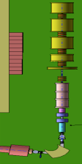
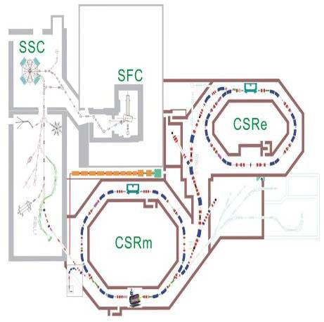
HIRFL Upgrading Plan
SSC-LINAC
Multi-injectors
Increasing Beam Intensity
ETF U
HILAC
HPLUS

Slide 12
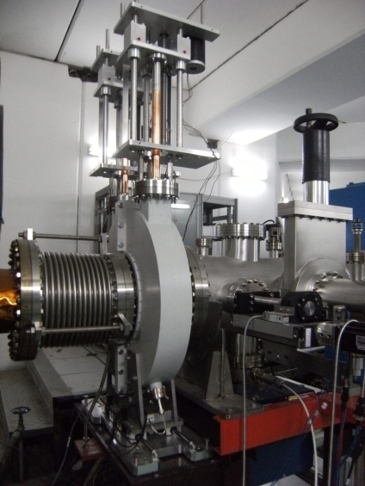
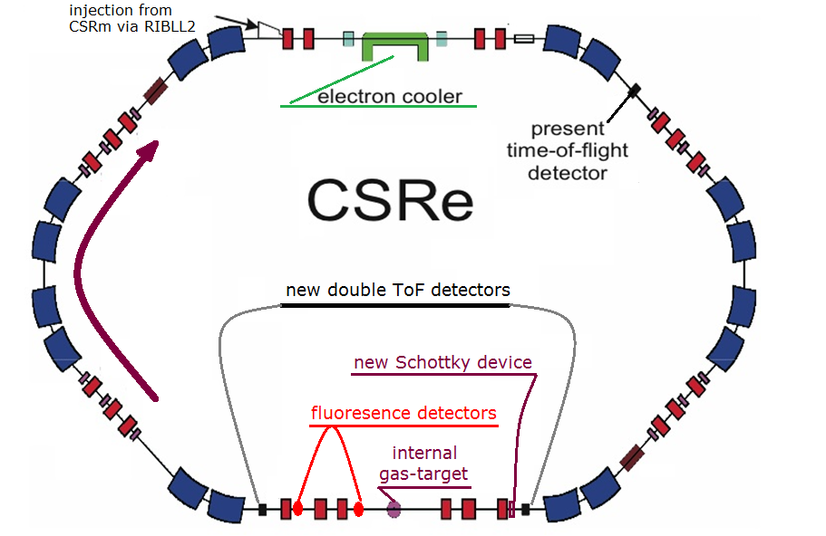
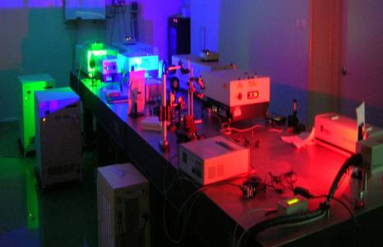
New installations @ CSRe
Decay properties of radioactive nuclides
Mass measurement for short lived nuclei
Laser cooling of ion beams
With new installation, we can perform

Slide 13
HIAF Project
High Intensity Heavy Ion Application Facility

Slide 14
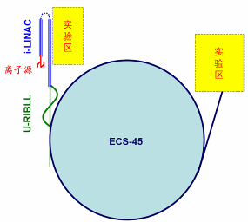
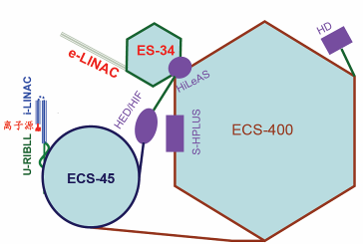
Future New Projects
 | Facilities | Research objectives
Phase I | HIAF | Energy, Space, Biology … Existence Limit of Nuclei, Universe… High Energy Density Physics (warm)
Phase II |  | Nuclon Structure Low energy hadron property High Energy Density Physics (hot)
Phase III |  | QCD test（QGP） HI driven ICF New Physics
Notes:
直线能量可再上提？流强指标不能降！

Slide 15
Physics programs under discussion in
Phase-I of HIAF
Nuclear Physics
Properties of Nuclear Matter, nuclear structure, mass measurement
Nuclear Astrophysics
High Energy Density Physics
EoS, metallic H₂
Atomic Physics @ Highly Charged Ions
relative energy ion-atom collisions, high precision x-ray spectroscopy, QED under super critical field, laser spectroscopy of radioactive ions, laser cooling of heavy ions and laser spectroscopy, precision dielectronic recombination
Irradiation Material Science by Heavy Ion Beams
Research on Space Irradiation and Radiation Biology by Heavy Ion Beams

Slide 16
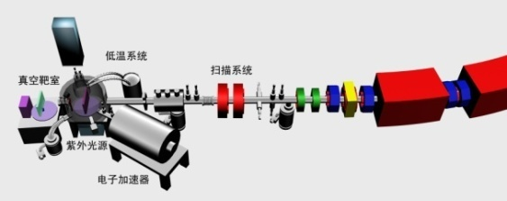
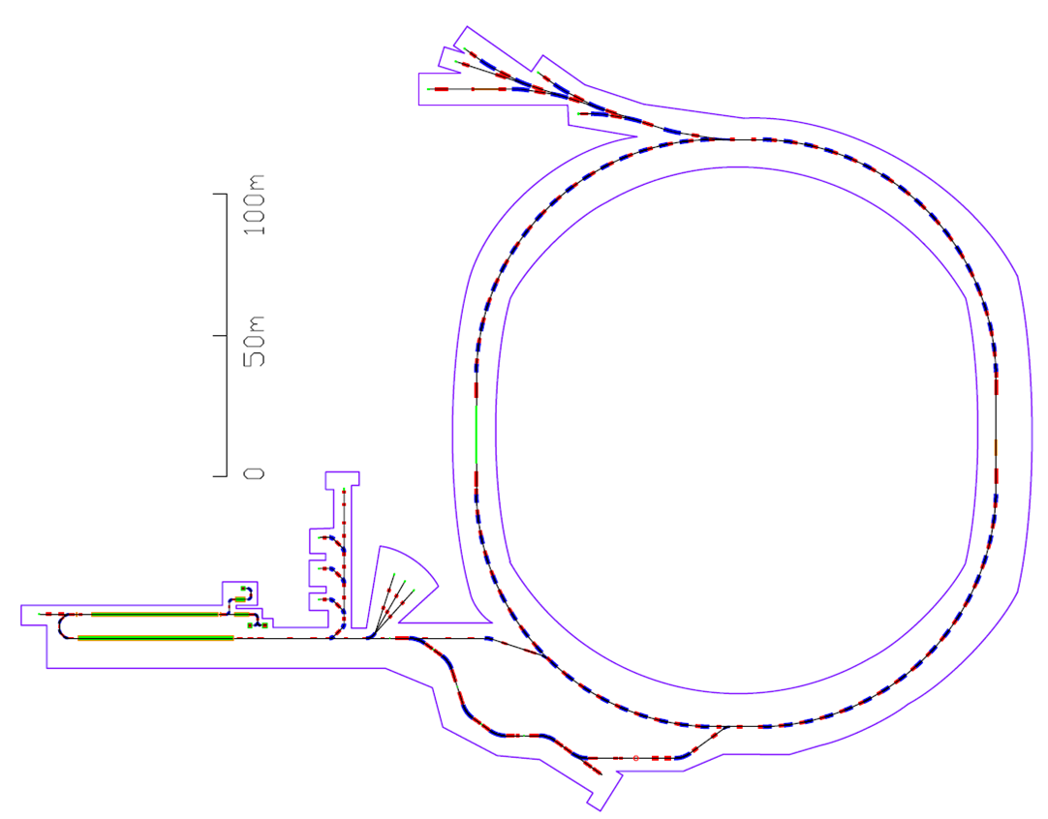
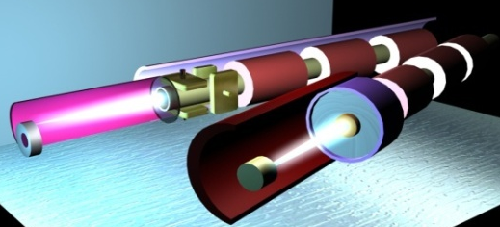
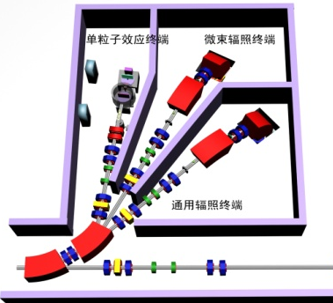
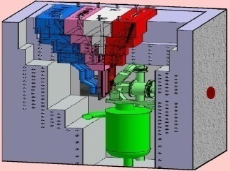
One Configuration of HIAF-I
Irradiation Setup
4 Beam Line 5 Exp. Setups
HEP Setup 10s kJ
Multi-Function Setup
Cooler-Synchrotron
ECS-45
(High Pulse Power)
Isochronisms'
Mass Measurement
(High Accuracy)
Material Setup
ECR LIS
i-LINAC
(Multi-Charge State)
U-RIBLL
(Large Acceptance)
Notes:
16

Slide 17
New Configuration of HIAF-I
Heavy Ion Accelerator Facility (Phase I)
2013~2020
Exp. Sites
Nuclear material
Multi-function irradiation site
RIBs Physics site
Mass spectrometry
HEZ radiation site
HED physics site
β-beam neutrino physics site
Beam Facilities
Ion Sources (LIS)
SC LINAC
Cooling
Radioactive Beam-line
Storage Ring Accelerators
SC-LINAC + Radioactive Beam-line + Storage Ring Accelerator
Notes:
多功能辐照站加墙；直线U字形（低能段拐回）；FRS型设计
两个注入点
破折线（双弯弯）去掉
材料线站换图

Slide 18


Suggested new configurations for experiments
Super critical fields exp.
High precision DR experiments
Merged beam design
One cooler, one electron target
Possibilities are Open for discussions and proposals at HIAF

Slide 19
HIAF Specification
Typical Beams and Performance
Subsystem |  | Ion Beam |  | E |  | I
i-LINAC |  | ⁸⁴Kr²⁷⁺ |  | 180 MeV/u |  | 10 pμA
 |  | ²⁰⁹Bi^{30+~31+} |  | 180 MeV/u |  | 12 pμA
 |  | ²³⁸U^{33+~34+} |  | 180 MeV/u |  | 10 pμA
U-RIBLL |  | RIBs |  | 150~220 MeV/u |  | ≤10⁹ pps
ECS-45 |  | Kr³⁶⁺ |  | 4.8 GeV/u |  | 1.0×10¹² ppp
 |  | Bi³¹⁺ |  | 1.2 GeV/u |  | 1.0×10¹¹ ppp
Budget: 1.5-2.0 bRMB
Notes:
In用激光离子源：10^12为隐性目标。
HIRFL指标：输出能量20J, 能量沉积率0.1J/g
SIS18指标：输出能量60J, 能量沉积率1kJ/g
SIS100指标：输出能量6kJ, 能量沉积率100kJ/g
LIAF指标：输出能量10kJ, 能量沉积率<200kJ/g
入射粒子种类 Kr
能量 0.4 GeV/u
束流强度 1*10^12 ppp
束流总能量 5.3kJ
纵向长度 100ns
束流功率 53GW
束斑直径 <1mm / 0.15~1mm
单位沉积能量 46kJ/g

Slide 20
ADS Project
Acceleration Driven Spallation system

Slide 21
Problems Faced
Nuclear Fuel Supply
Nuclear Waste Management
²³⁵U: conventional reactor
²³⁸U: fast reactor
²³²Th: TMSR
One through: directly deep disposal
Closed cycle: Pu, ²³³U, ²³⁵U, and then disposal
ADS: MAs & LLFPs transmutation
Advanced Nuclear Fission Energy for Future
Supported by the “Strategic Priority Research Program” of CAS
Notes:
21
21

Slide 22

ADS – Schematic diagram
Intensive & energetic protons bombarding spallation target
Constitutions of ADS
Accelerator
Spallation Target
Subcritical Reactor
Widely distributed neutron production
ADS to be considered as the best solution for nuclear waste transmutation.
Transmutation of MAs and LLFPs
Notes:
22
22

Slide 23
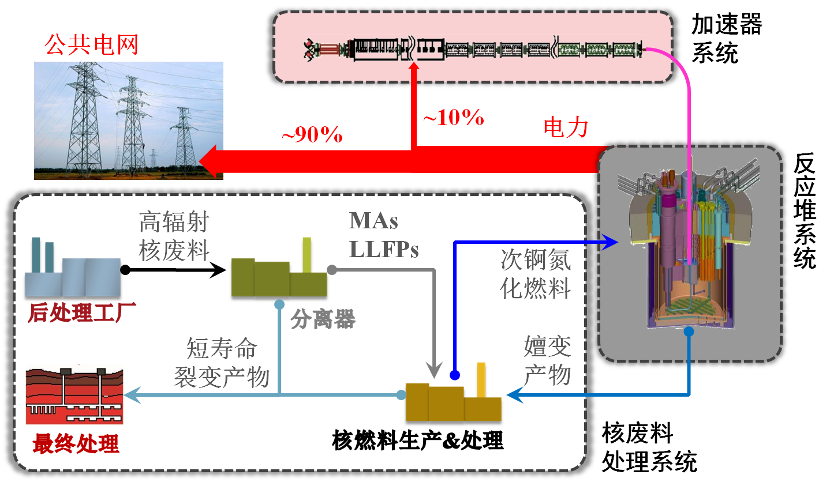
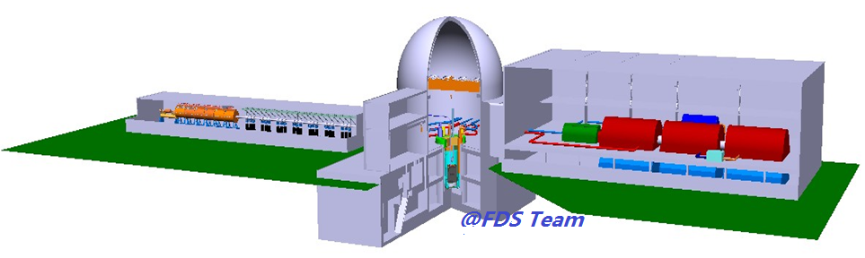
ADS – Nuclear Waste transmutation Cycle
Industrial electric power system
Accelerator
Power Generation
Radioactive waste
MAs & LLFPs
Fuels with MAs
Reprocessing
Separation
Short-lived fission products
Transmuted Products
Reactor
Waste Processing System
Waste Disposal
Fabrication of fuel elements
Notes:
23
23

Slide 24


ADS Roadmap in CAS
Phase IV (2023-2032)
Phase III (201X-2022)
Phase II (2016-201X)
Phase I (2011-2015)
Injector 1
Injector 2
10 MeV
5~10 MW_{t}
100 MW_{t}
≥1 GW_{t}
2013
~5 MeV
2015
25~50 MeV
201X
150/200 MeV
~2022
0.6~1 GeV
~2032
1.2~1.5 GeV
Individual key tech. R&D
Acc. & target & reactor prototype
ADS Test Setup
Exp. Facility
Demo Facility
Notes:
24

Slide 25
Acknowledgements to
HIRFL team
CSR experimental Team
HIAF working group
ADS working group
Collaboration with GSI
Collaboration with MPIK
…… ……

Slide 26
Thank you for your attention

Slide 28
External target set-up
Observables:
n/p and π+/π− ratios
Nucleon differential flow
Hard photons
Study structure of exotic nuclei, and constrain the properties of neutron star

Slide 29
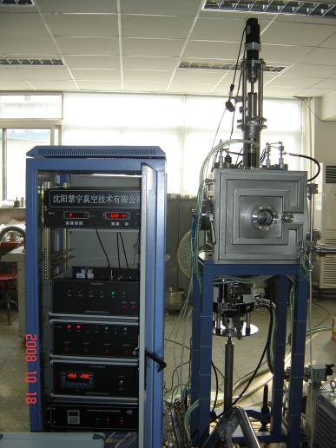
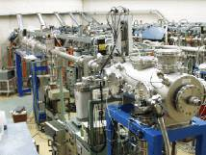
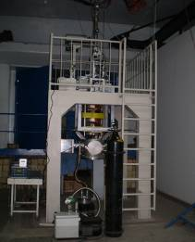
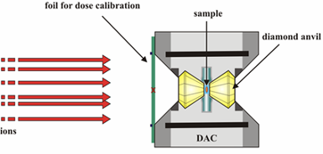
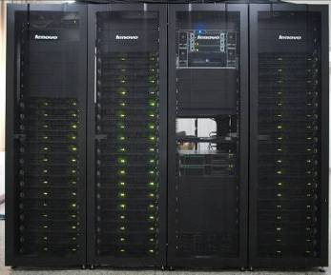
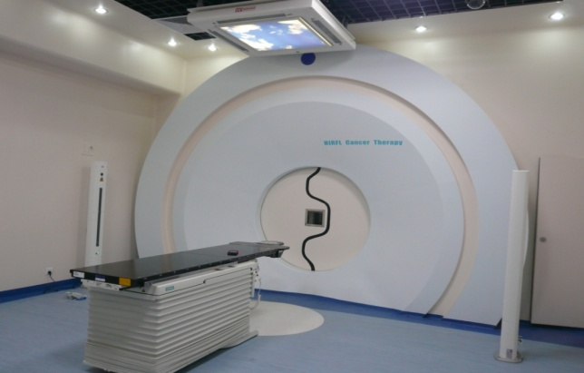
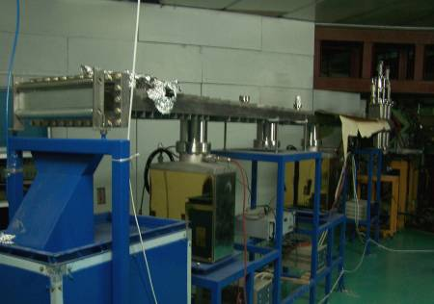
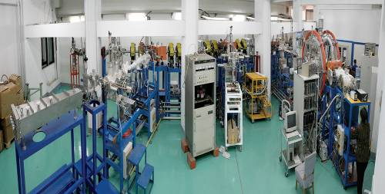
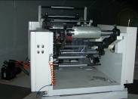
Main setups for H.I applications
Irradiation Material
Laser
Space Industry
Micro-beam
HIRFL
High Pressure
High speed GPU
Cancer Therapy
Irradiation film
320 kV HV platform

